Slide 1
Rock n Roll Marathons Insights
Exploration of half and full marathon data 2016-2019
By: Alan Godwin, Jeremy McCormick, and Stephanie Rivero

Slide 2

Rock and Roll Marathon 2016-2019
Fastest & Slowest Times
Mean & Median Times
Why?
Outliers

Slide 3
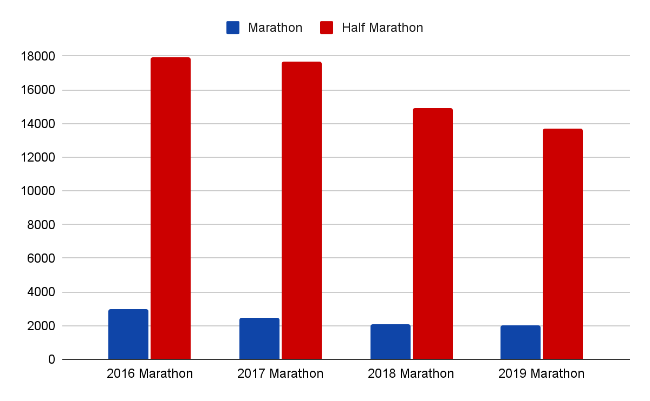
Race participants over the years

Slide 4
Time Statistics
Race | Fastest Time | Slowest Time | Median Time | Mean Time
2016 Marathon | 2:25:42 | 7:00:00 | 4:45:19 | 4:47:48
2017 Marathon | 2:40:25 | 6:38:19 | 4:58:14 | 4:54:26
2018 Marathon | 2:28:16 | 6:34:41 | 4:48:21 | 4:48:23
2019 Marathon | 2:34:59 | 6:43:55 | 4:41:57 | 4:42:09
2016 Half | 1:11:15 | 4:54:41 | 2:26:18 | 2:31:57
2017 Half | 1:10:58 | 6:18:24 | 2:39:34 | 2:43:59
2018 Half | 1:09:25 | 4:48:06 | 2:25:32 | 2:31:46
2019 Half | 1:10:03 | 5:03:35 | 2:26:07 | 2:32:07

Slide 5
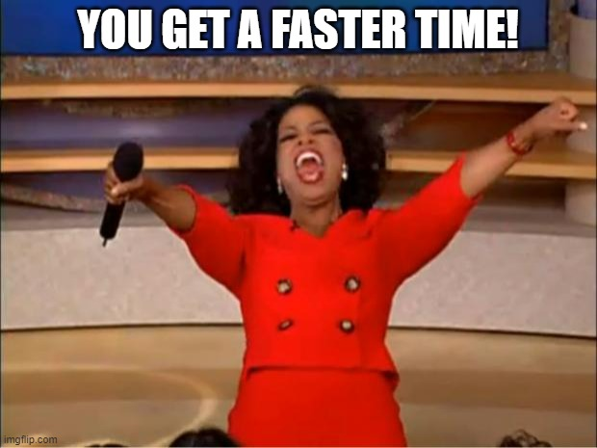
Oprah Meme
America’s favorite television personality
Notes:
In 1994 Oprah Winfrey ran in the Marine Corps Marathon and finished with a time of when she was 40 years old. Her finish time was

Slide 6
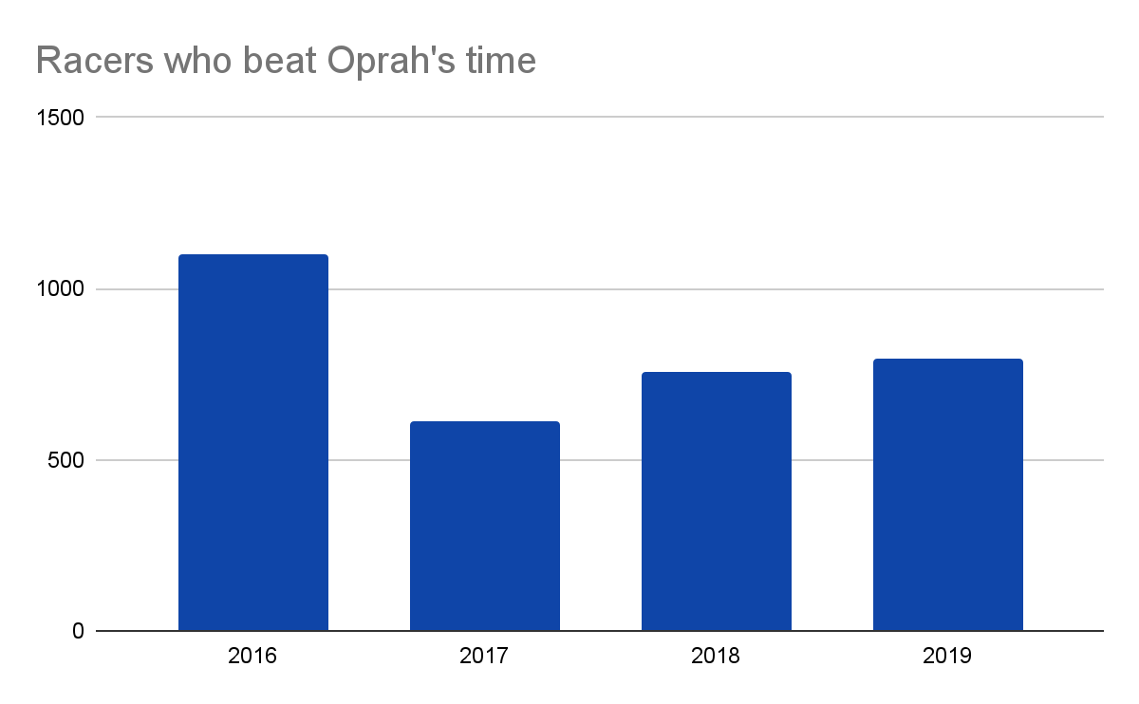
Notes:
Better Than Oprah's Time Percentage BTOT
1099 37%
615 25%
756 36%
793 39%

Slide 7
Slowest Year
By our analysis we determined that 2017 was the slowest year of marathon runners
Quartiles
 | Quartiles for half marathons | 1st Quartile | 2nd Quartile | 3rd Quartile
 | 2016 | 2:08:18 | 2:26:18 | 2:50:11
 | 2017 | 2:18:17 | 2:39:34 | 3:05:10
 | 2018 | 2:07:21 | 2:25:32 | 2:51:16
 | 2019 | 2:07:04 | 2:26:07 | 2:51:30

Slide 8
Weather
2017 had the hottest weather out of the marathons based on https://www.timeanddate.com/
weather of marathons 6a-12pm
 | date | temp low | temp high | humidity
2016 | 4/30/2016 | 64° | 70° | 87%
2017 | 4/29/2017 | 73° | 91° | 69%
2018 | 4/28/2018 | 50° | 72° | 52%
2019 | 4/27/2019 | 45° | 45° | 48%

Slide 9
Participation
Participation was high in 2017
Year | Runner Count
2016 | 17917
2017 | 17699
2018 | 14925
2019 | 13703

Slide 10
Participation Decline
New ownership in 2018 (article)
Participation of Marathons has declined 13% since 2016 according to report.
Less experienced runners each year can cause slower times

Slide 11
Outliers

Slide 12
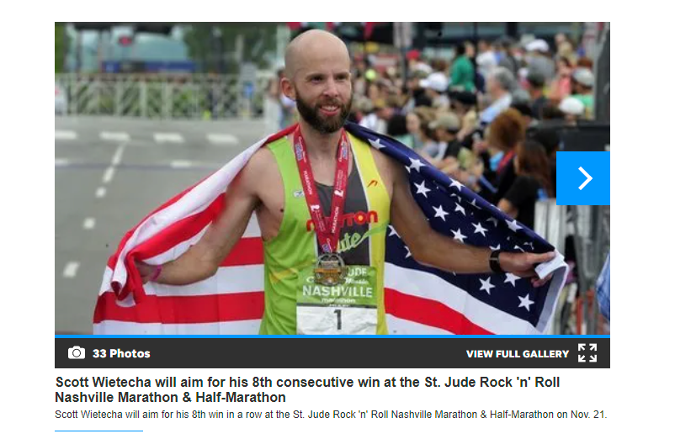
Historic win streak

Slide 13
Repeat Winner
2016 - 2:25:42
2017 - 2:40:25
2018 - 2:28:16
2019 - 2:34:59
Routine: 100 miles weekly, running coach, and multiple marathons per year.
Scott Wietecha

Slide 14
A Slow Year
In 2017 -
Both the full and half marathons had slower times.
4th Quartile difference: 0:19:55
Full Marathon: 2466 runners
Half Marathon: 17699 runners
> 6:00:00
Full Marathon: 67 runners
Half Marathon: 1 runner

Slide 15
<6:00:00
<4:00:00
2016 Full: 241 Runners, 8%
2018 Full: 153 Runners, 7%
2019 Full: 78 Runners, 4%
2016 Half: 264 Runners, 1%
2018 Half: 234, 2%
2019 Half: 225, 2%

Slide 16
4% & 1%
Average <3:00:00 marathon completion for each gender
https://www.livestrong.com/article/13763749-marathon-statistics/

Slide 17
Is Nashville Fast?
2016:‌ 16 Runners, 1%
‌2017:‌ 2 Runners, 0%
‌2018:‌ 16 Runners, 1%
‌2019:‌ 16 Runners, 1%
Times <3:00:00

Slide 18
Thank You
&
Questions

